Slide 1
Human Activity Recognition
Niranjan Under the guidance from Dr. Subhashis Banerjee and Dr. Parag Singla Department of Computer Science, IIT Delhi
M.Tech Project Presentation – September 20, 2013

Slide 2
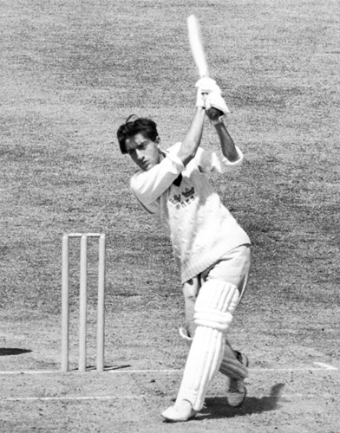
Problem Statement
What is Video Activity Recognition?
Play

Slide 3
Approach
Actions in Context
by Ivan Laptev et. al. in Proc. CVPR'09
Improving Video Activity Recognition using Object Recognition and Text Mining
by Tanvi Motwani and Raymond J. Mooney, ECAI-2012

Slide 4
Approach
Classification based on HoGHoF features
Probability of Objects using Object Detection
Predictions

Slide 5
Approach++
Classification based on HoGHoF features
Probability of Objects using Object Detection
Probabilistic Inference Logic using MLN
Predictions

Slide 6
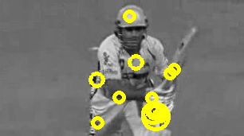
Classification using HoGHoF
Extracting STIP features
STIP HoG and HoF feature vector :
0.627496 0.0892087 0.0293946 0.253901 0.668772 0.160494 0.000758835 0.169975 0.414533 0.508073 …
…...
…...

Slide 7
Classification using HoGHoF
Describe a video clip as bag-of-features.
Cluster all HoGHoF feature descriptors using k-means.
Represent clip as a histogram over these clusters
Train a classifier
Supervised - Dataset is pre labeled

Slide 8
Object Detection
Using Discriminatively Trained Deformable Part Models
Pre-trained object detector for 19 objects

Slide 9
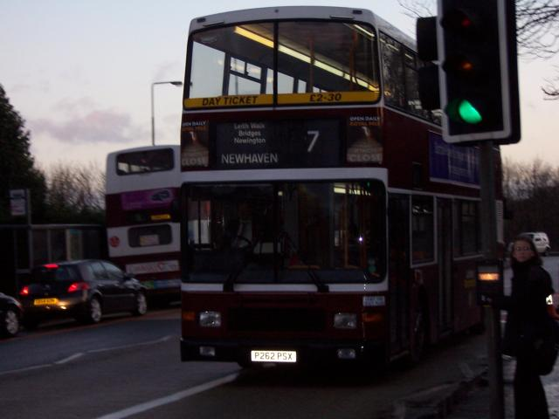
Object Detection

Slide 10
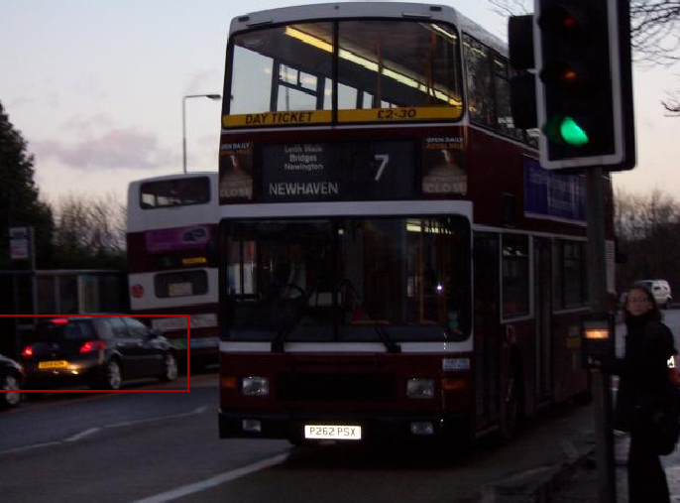
Object Detection

Slide 11
Relation between Activity and Objects
English Gigaword Corpus – 15 GB of raw text
Occurrence counts:
of an activity A_{i}: occurrence of the verbs
of an object O_{j}: occurrence of object noun O_{j} or its synonym.
Co-occurrence of an Activity and an Object:
POS Tagging
Using Stanford tagger.
Occurrence of the object ( tagged as noun ) within a window of w or fewer words of an occurrence of the activity ( tagged as verb ).

Slide 12
Relation between Activity and Objects
Probability of each activity given each object

Slide 13
Integrated Activity Recogniser
P(A_{i} | F_{v}) – Calculated in 1st part.

Slide 14
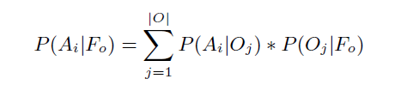
Integrated Activity Recogniser
P(A_{i} | F_{v}) – Calculated in 1st part.
P( A_{i} | F_{o} ) -
Gigaword Corpus
Object Detector

Slide 15
Integrated Activity Recogniser
P(A_{i} | F_{v}) – Calculated in 1st part.
P( A_{i} | F_{o} ) -
Consider only P ( A_{i} | F_{v} ) when no object is detected and P ( A_{i} | F_{o} , F_{v} ) when objects are recognized

Slide 16
Morkov Logic Network
Inference using Knowledge – First Order Logic
Probabilities – Handle probabilities with FOL
Problems with Pure Logic and Pure Probabilities
MLN – Assign real valued weights to rules
Learn the weights

Slide 17
Work Done
STIP features extraction done.

Slide 18
Work Done
STIP features extraction done.
Clustering – k-means clustering integrated in pipeline.

Slide 19
Work Done
STIP features extraction done.
Clustering – k-means clustering integrated in pipeline.
Bag-of-Features representation of video clips.

Slide 20
Work Done
STIP features extraction done.
Clustering – k-means clustering integrated in pipeline.
Bag-of-Features representation of video clips.
Learning a model

Slide 21
Work Done
STIP features extraction done.
Clustering – k-means clustering integrated in pipeline.
Bag-of-Features representation of video clips.
Learning a model
Work To be Done
Object Detection, Learning Gigaword Corpus.
Markov Logic Network implementation.

Slide 22
References
Actions in Context by M. Marszalek, I. Laptev and C. Schmid; in Proc. CVPR-2009
Improving Video Activity Recognition using Object Recognition and Text Mining by Tanvi Motwani and Raymond J. Mooney, ECAI-2012
Markov Logic by Pedro Domingos, Parag Singla, et.al., Probabilistic Inductive Logic Programming (pp. 92-117), 2008. New York: Springer.

